Slide 1
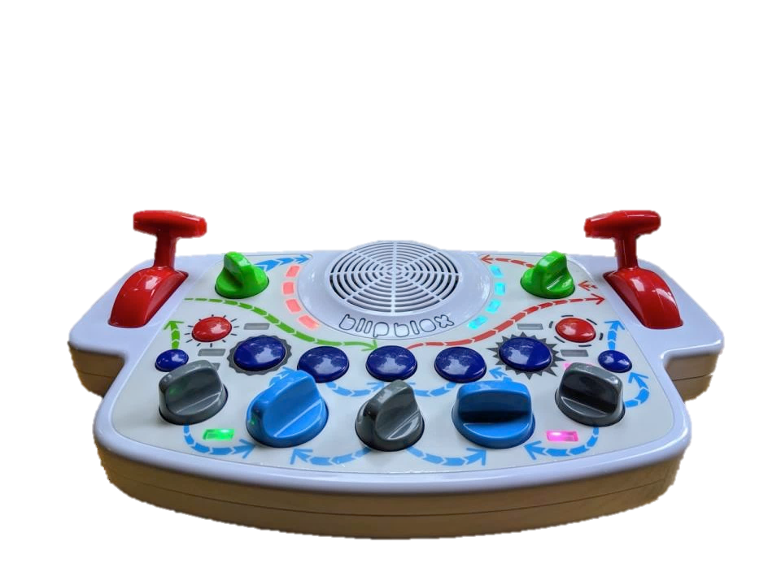
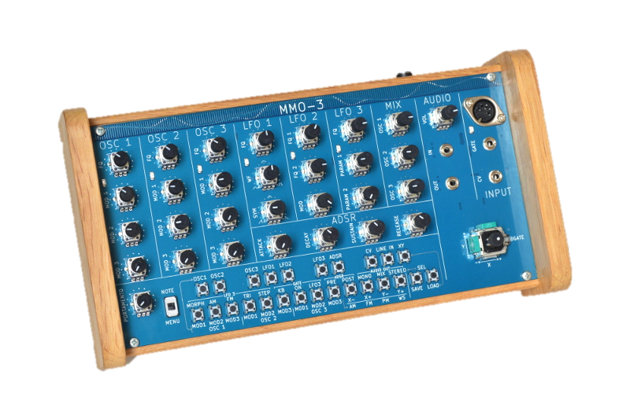
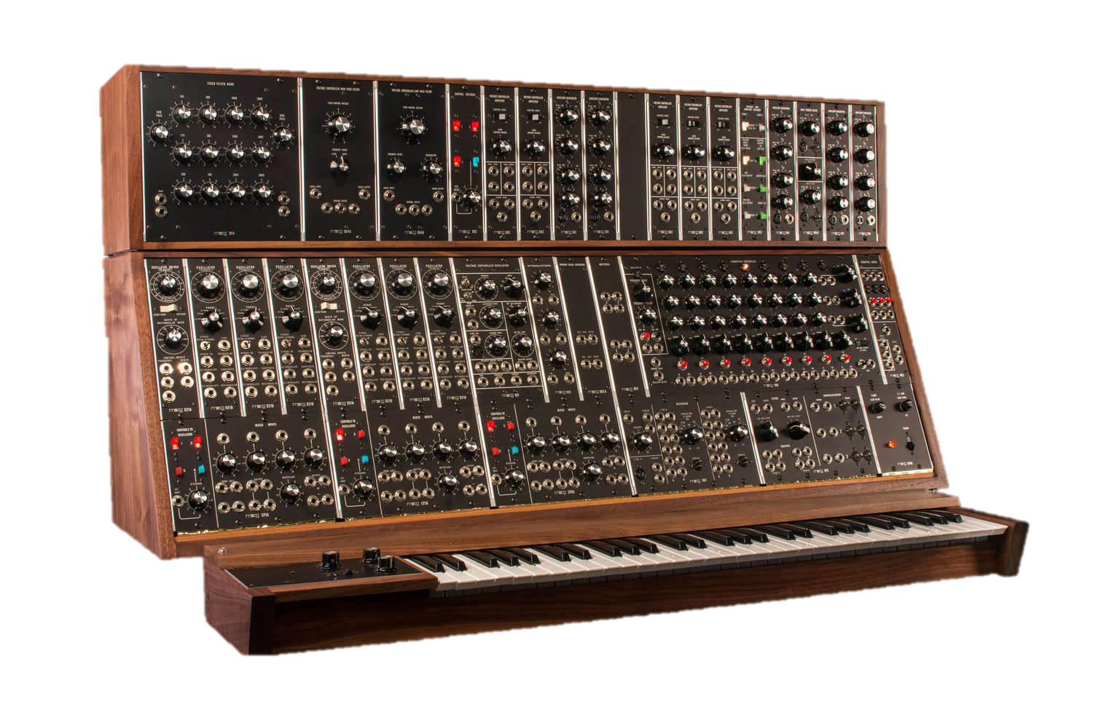
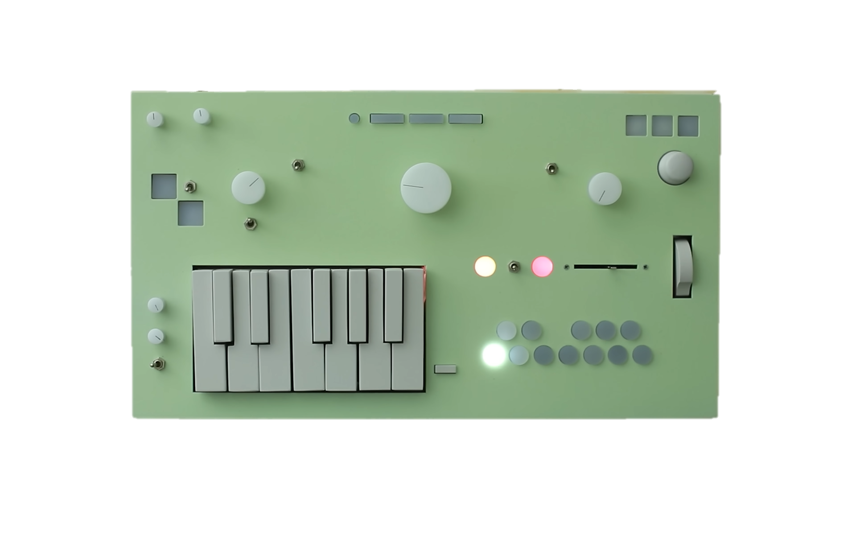

Slide 2
Synthesizer - noun
syn·​the·​siz·​er
a usually computerized electronic apparatus for the production and control of sound (as for producing music)

Slide 3
Synthesizer - noun
syn·​the·​siz·​er
an electronic apparatus capable of producing a wide range of sounds, thus providing for a meditative experience

Slide 4
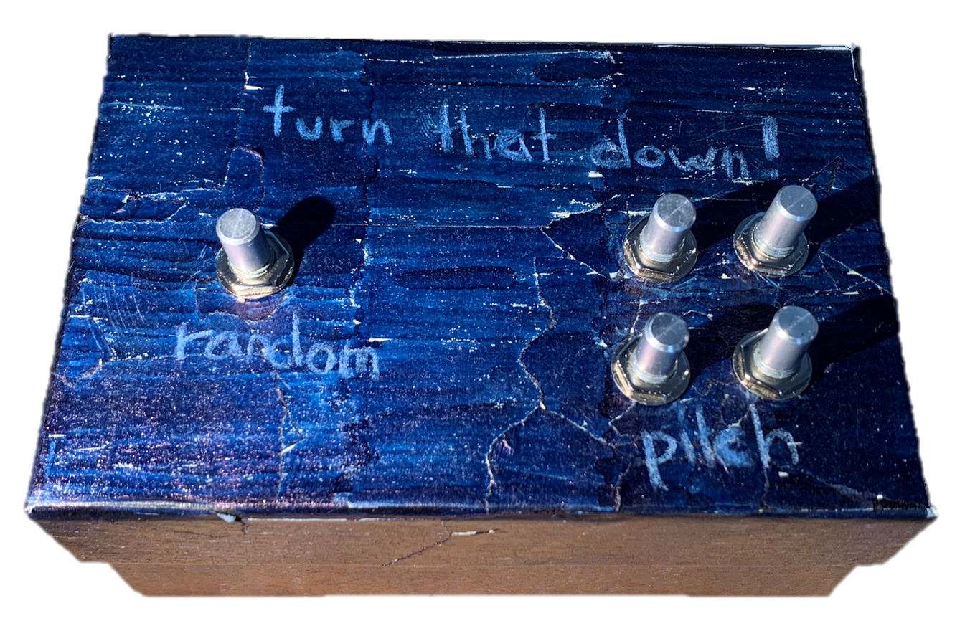
t u r n
t h a t
!
d o w n

Slide 5
turn that down! The Creation of a Synthesizer

Slide 6

content
motivation
theory
my synthesizer
work process
conclusion
demo

Slide 7
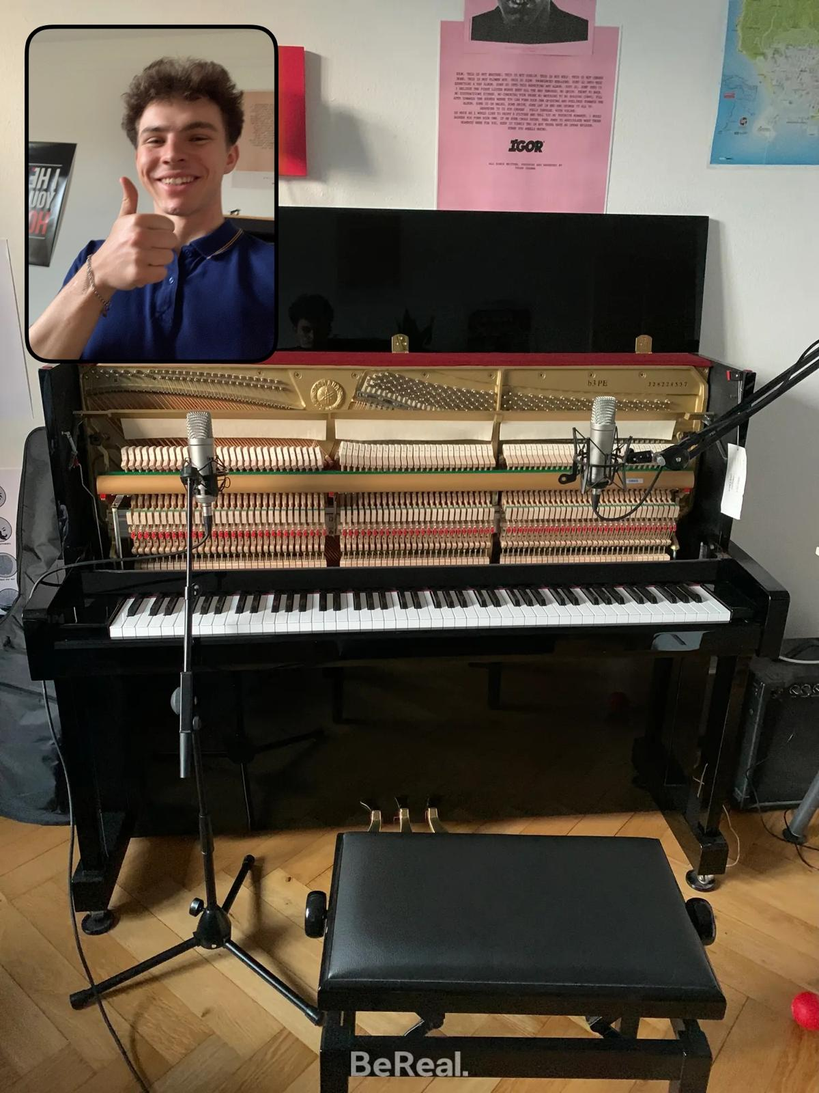
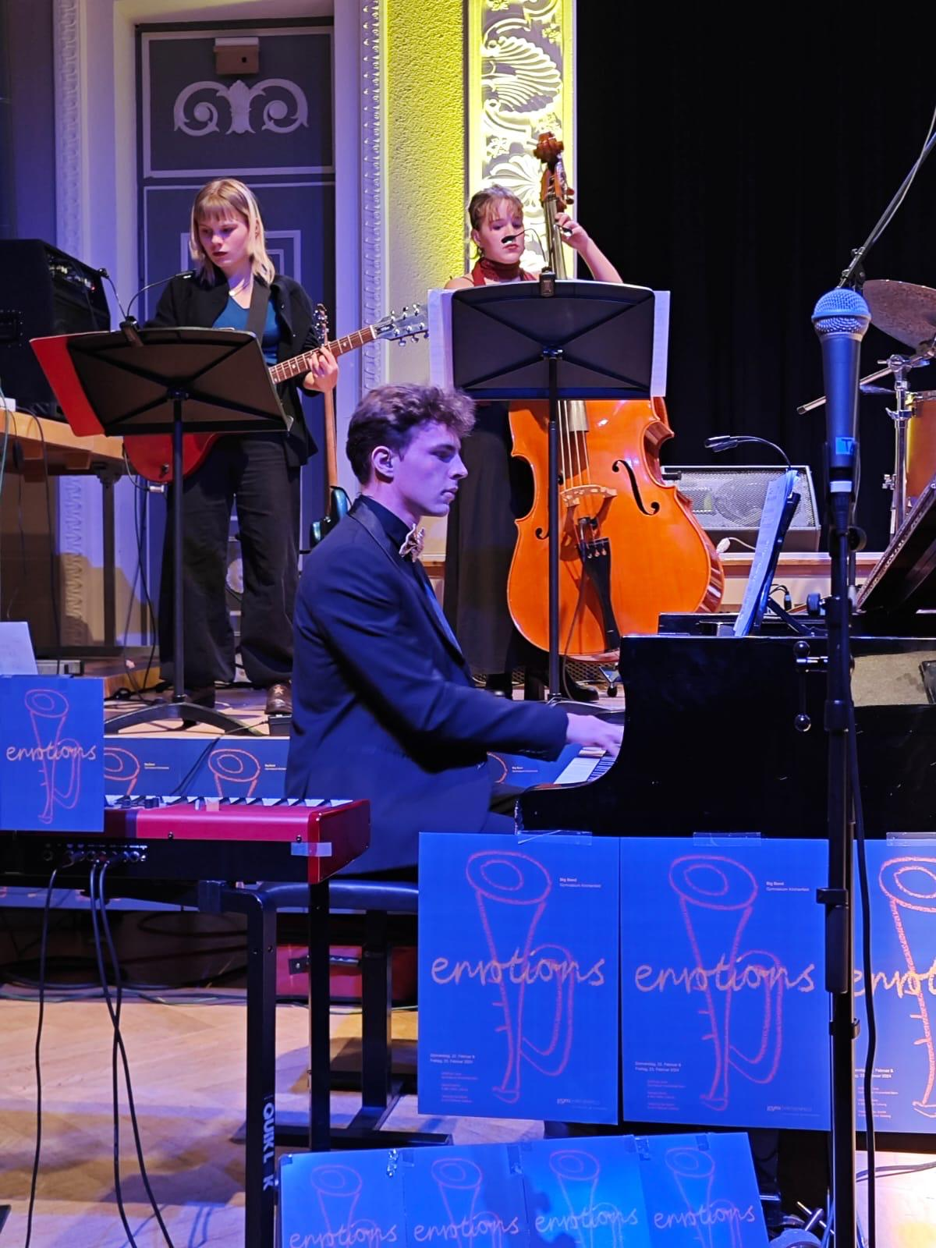

motivation

Slide 8
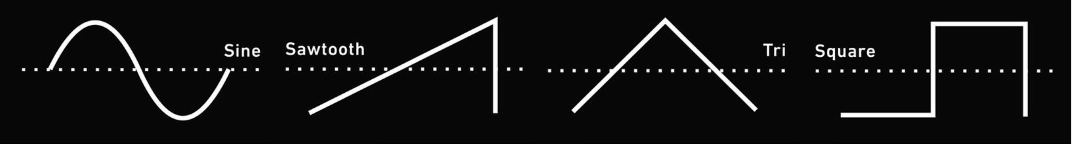

theory – waveshapes

Slide 9
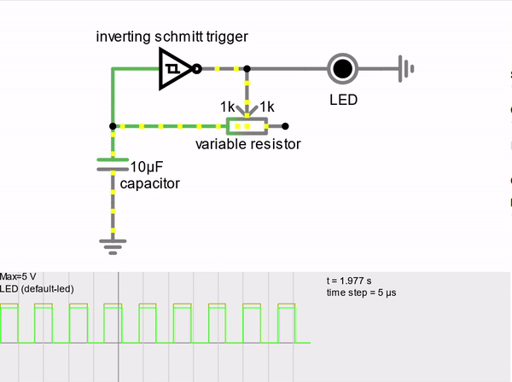
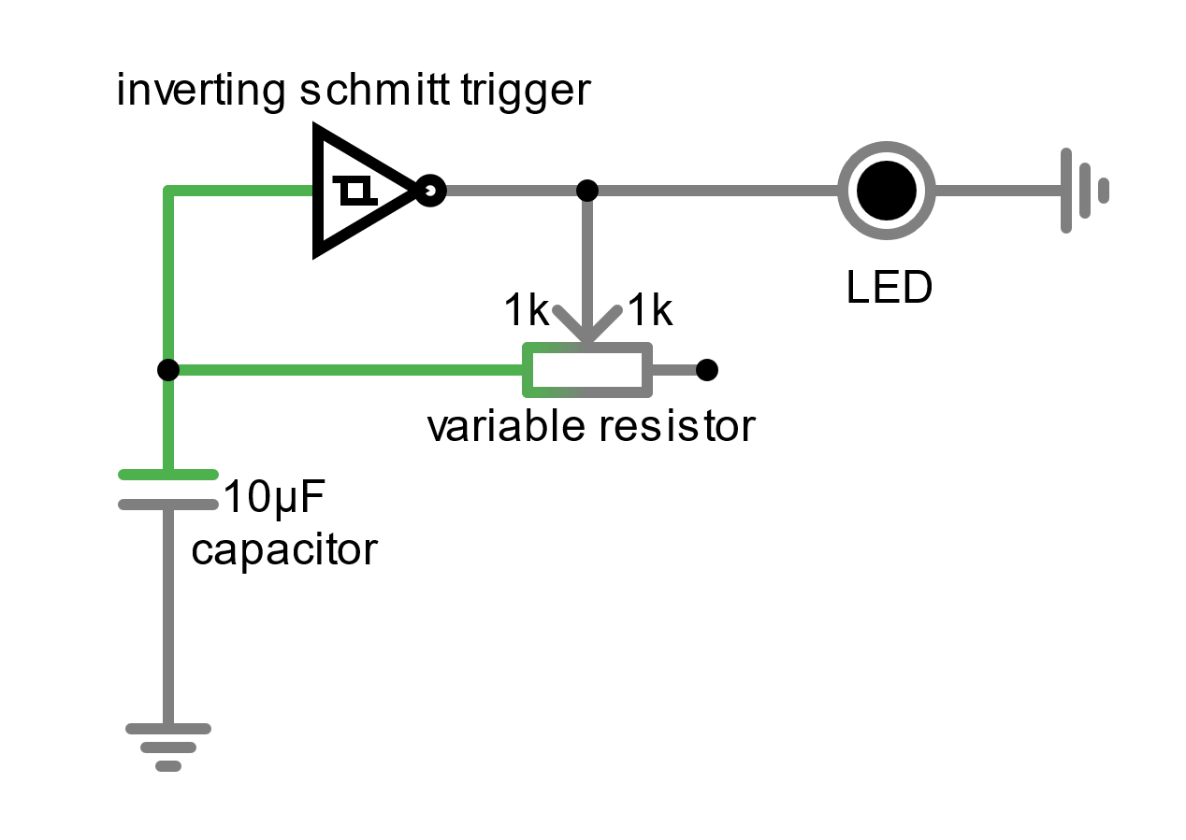

Slide 10
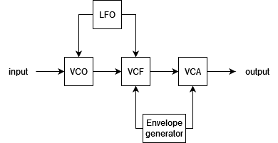
theory

Slide 11
theory
VCO
VCF
VCA
LFO
voltage controlled oscillator
voltage controlled filter
voltage controlled amplifier
low frequency oscillator
envelope generator

Slide 12
theory
VCO
MA, square wave
voltage controlled oscillator

Slide 13
theory
VCF
voltage controlled filter

Slide 14
theory

Slide 15
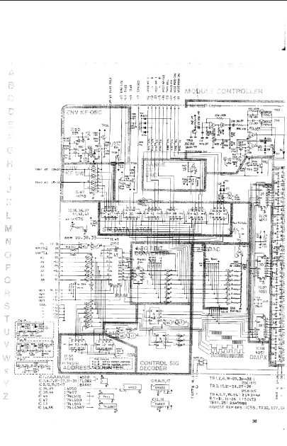
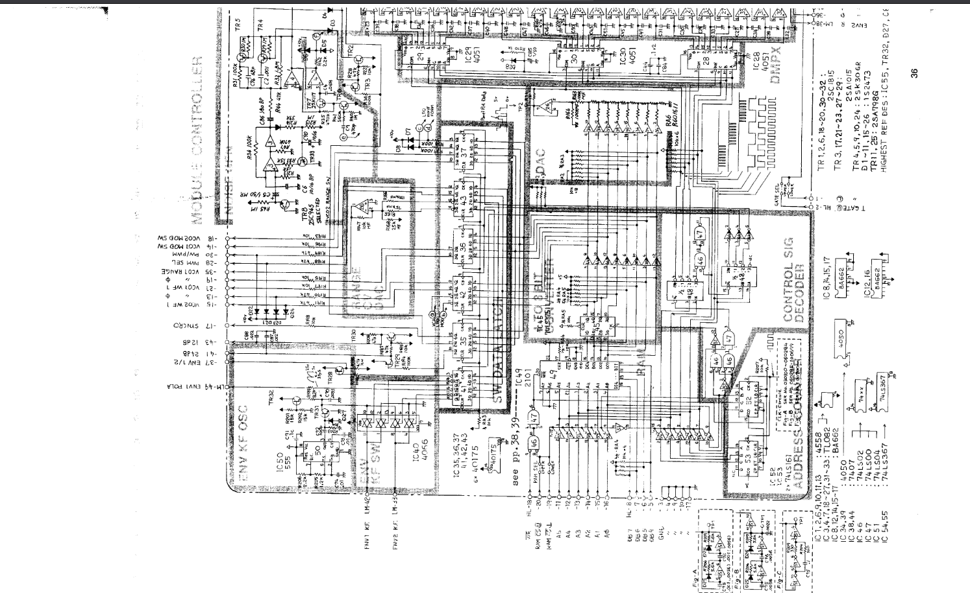
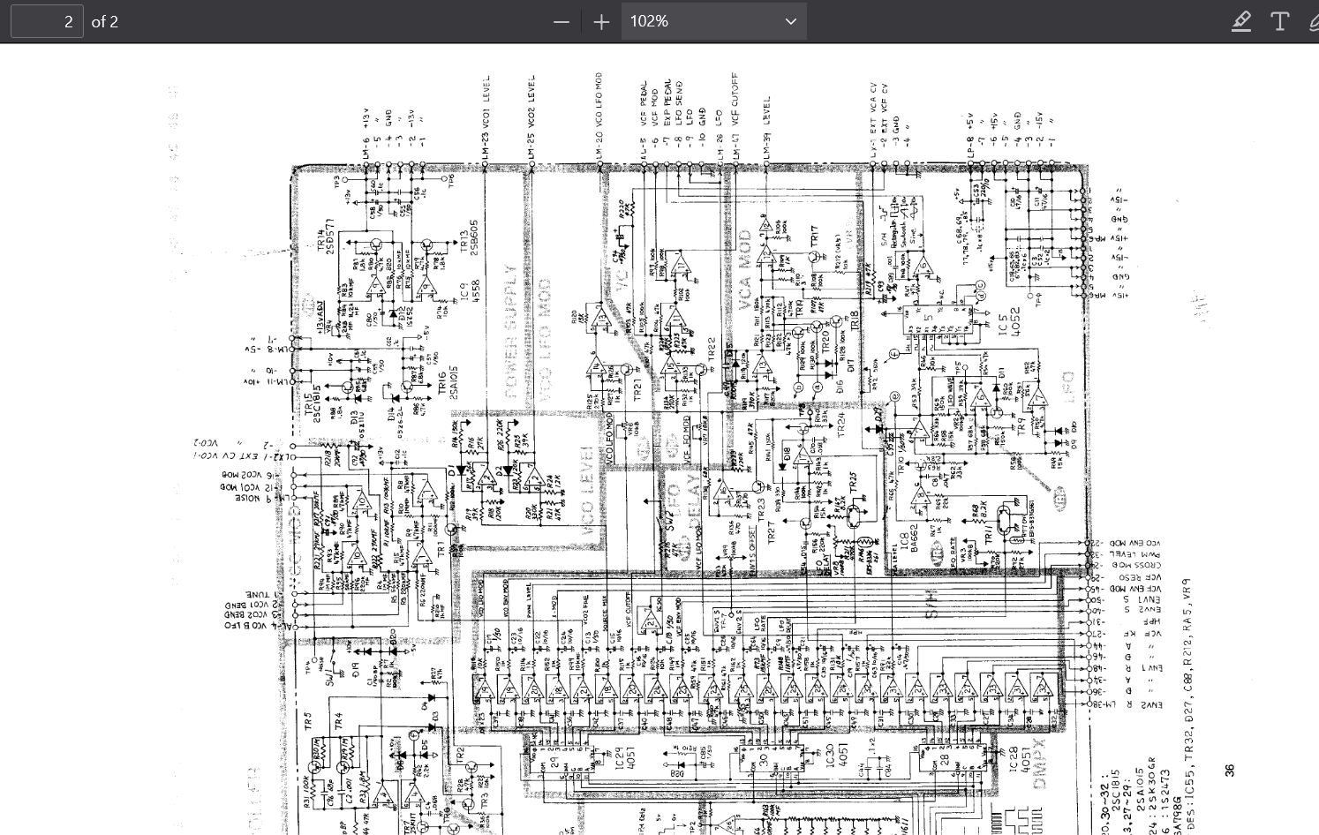
theory
VCO
VCF

Slide 16
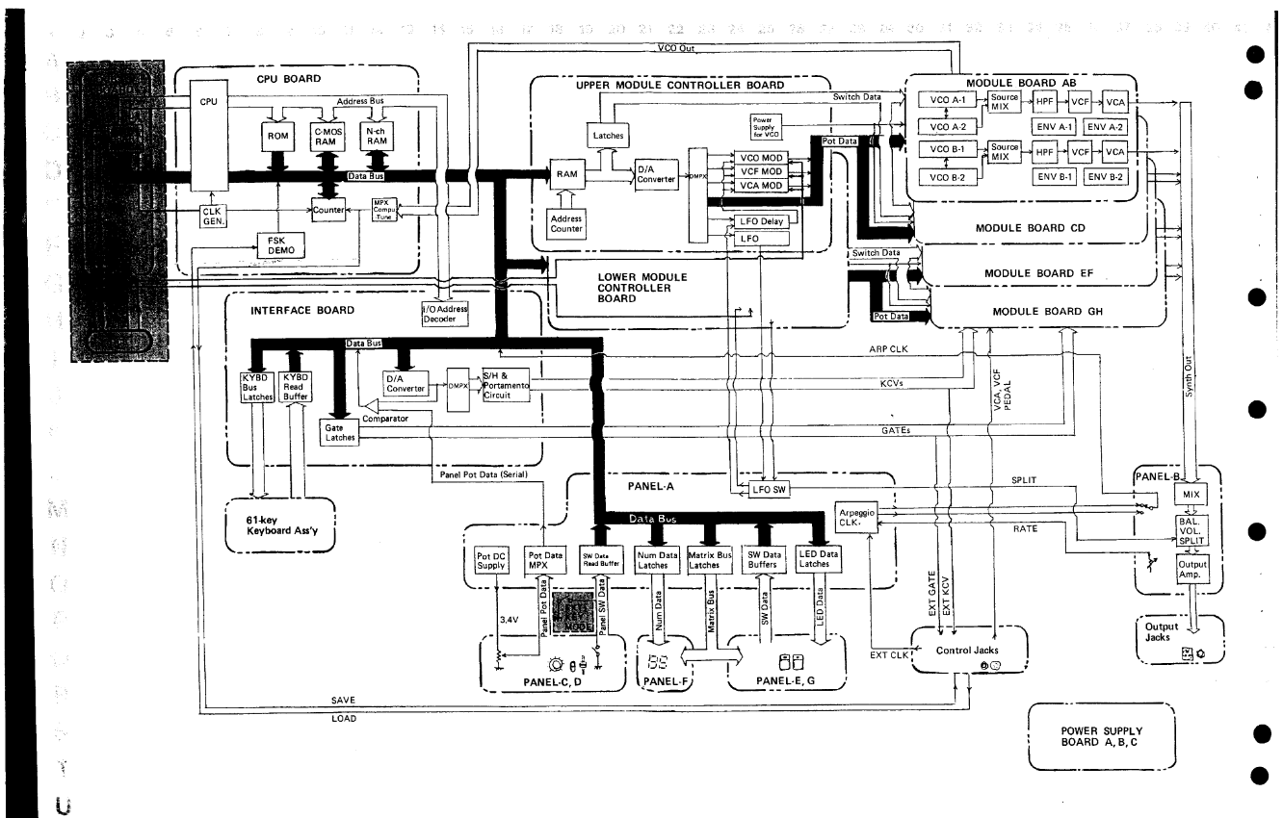
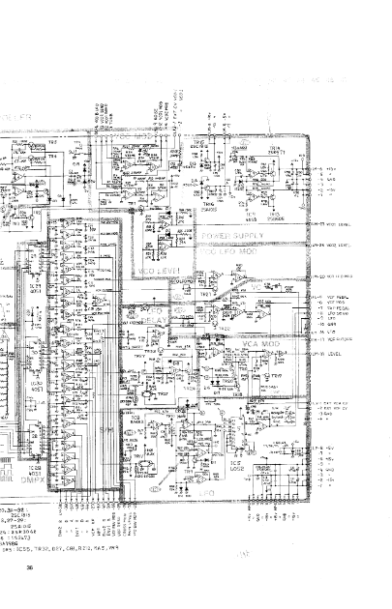
theory
VCO
VCF

Slide 17
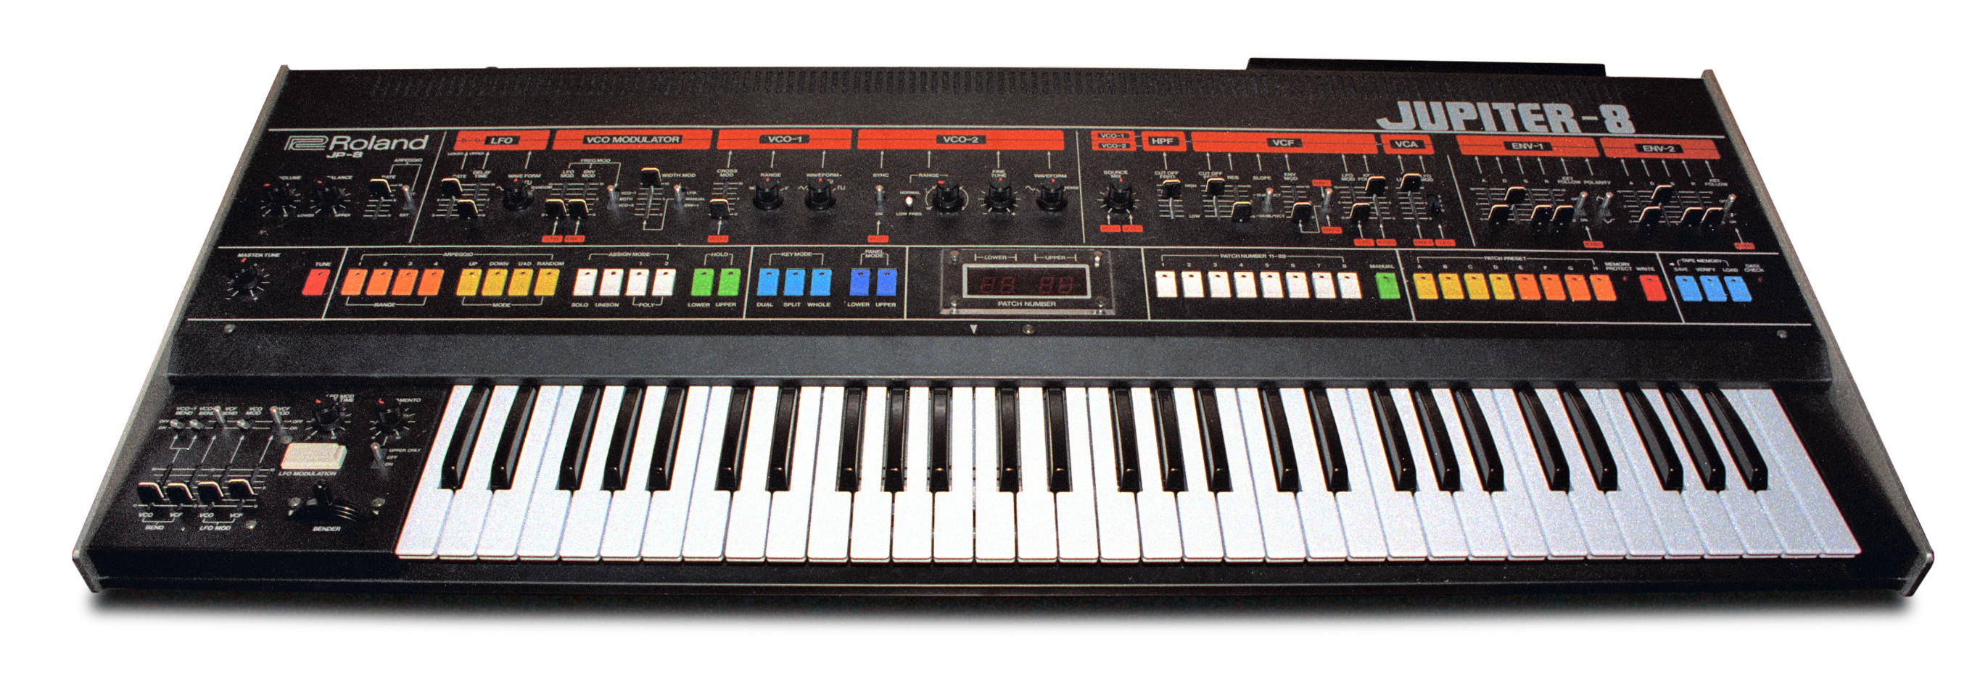
VCO
VCF

Slide 18
theory
VCO
VCF

Slide 19
theory
VCO
VCF

Slide 20
theory
VCO
VCF

Slide 21
theory
VCO
VCF

Slide 22


my synthesizer
oscillator 1
oscillator 3
output
low pass filter
oscillator 2
oscillator 4

Slide 23
my synthesizer
osc 3
osc 4
output
random
osc 1
osc 2

Slide 24
work process

Slide 25
conclusion

Slide 26
demonstration

Slide 27
sources
Moog 08.12 https://www.moogmusic.com/news/return-moog-modular
Children 08.12 https://www.engadget.com/2019-07-03-blipblox-hands-on-synthesizer-for-kids.html
Mmo-3 08.12 https://www.factmag.com/2017/05/24/nozoid-mmo-3-drone-synth/
Nopia 08.12 https://youtu.be/Ivuy9QYLFVY

